Slide 1
Collaborative Platform 5
Team Members
Product Owners
Jorge Travieso
Adrian Alfonso
Juan Caraballo
Robert Loredo
Spring 2015

Slide 2
Problem Solution
Need for
Better interaction among users of the system.
Fast way to set up meetings.
The Collaborative Tools
Video Conference
Screen Sharing
Virtual Whiteboard
Chat Room
Simple Scheduling

Slide 3




Sprint # 3 Planning
8 Points
8 Points
8 Points
8 Points

Slide 4
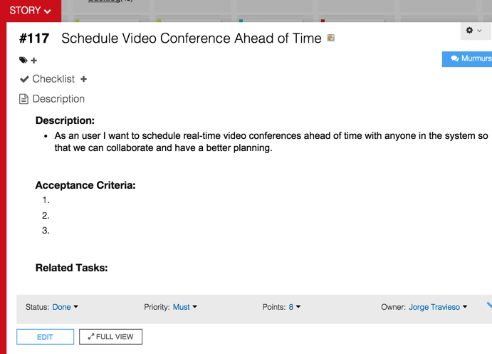

Slide 5
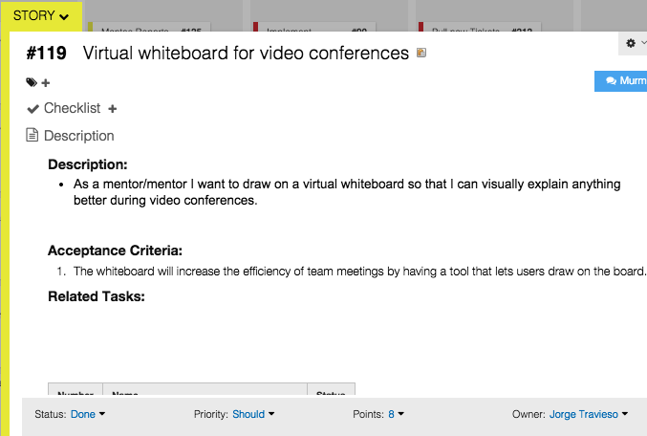

Slide 6
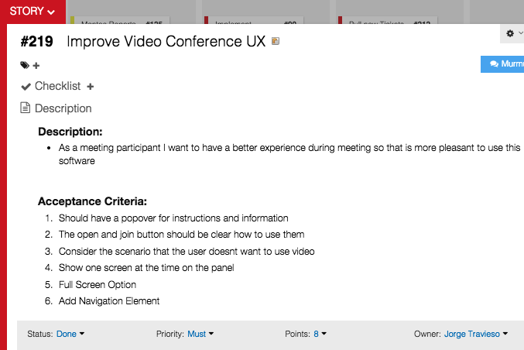

Slide 7
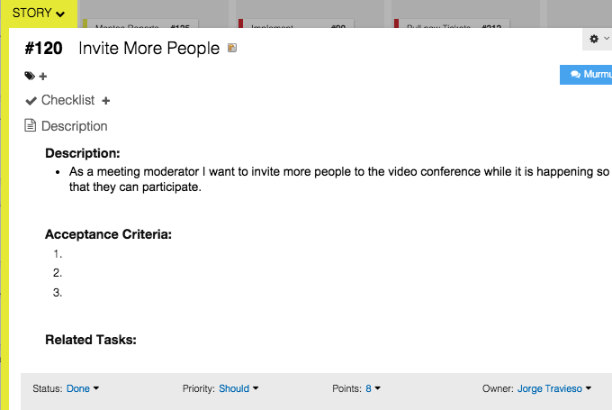

Slide 8
Sprint #3 Planning
4 User Stories
Personal Mark: 32 Points / 32 Planned
Sprint Velocity: 64 Points
Estimate based on
Documentation update time
Design and implementation

Slide 9
Self Review
User Story | Status | Accepted
Schedule VC Ahead of Time | Done | Accepted
Improve Video Conf. UX | Done | Accepted
Invite More People | Done | Accepted
Virtual Whiteboard | Done | Accepted

Slide 10
Daily Scrums Summary
Major Accomplishments
Updated the documentation
Use case model, sequence diagrams, test cases
Heavily updated the UI appearance
Added features
Virtual whiteboard
Schedule meetings ahead of time.
Invite people from video conference

Slide 11
Documentations Updates

Slide 12
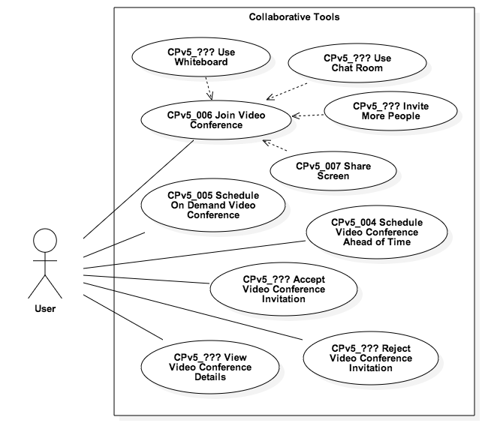
Use Case Model

Slide 13
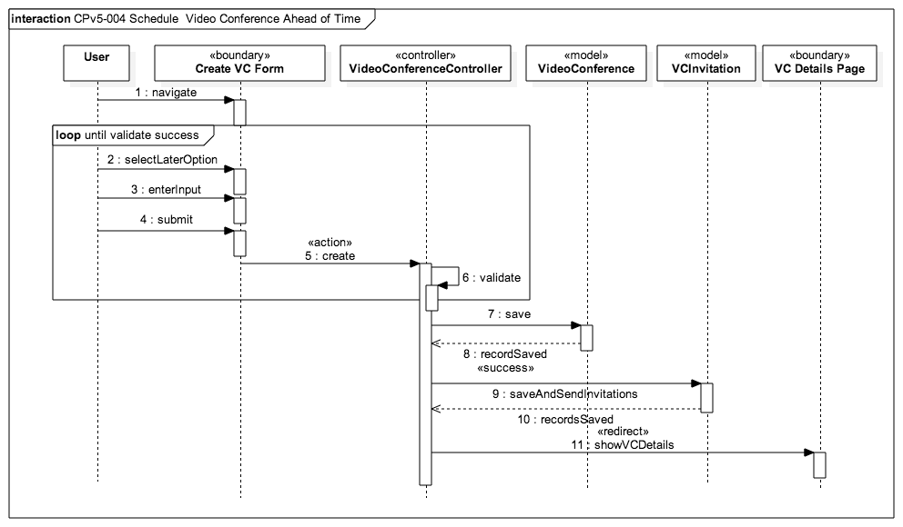

Slide 14
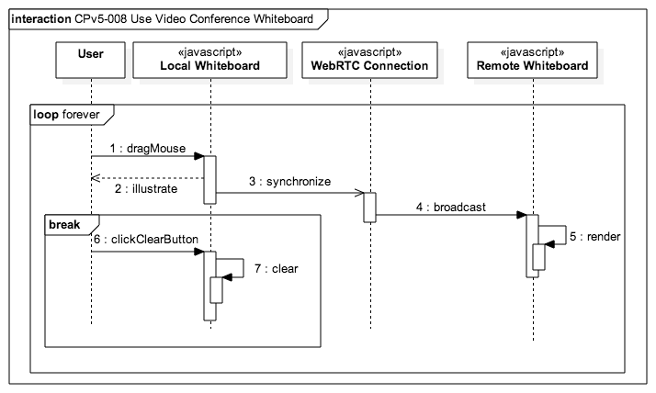

Slide 15
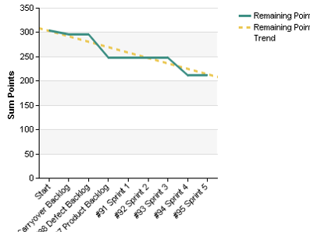
Burndown Chart

Slide 16
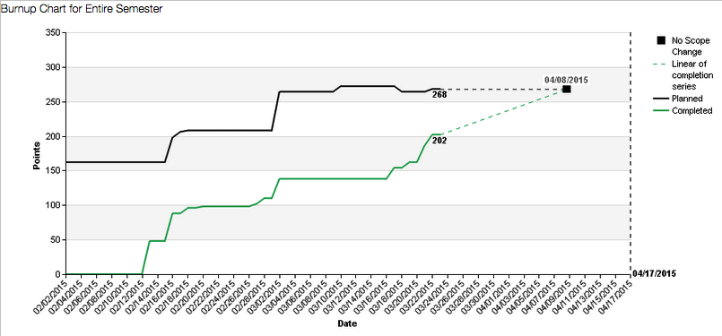
Burnup Chart

Slide 17
Demo
http://cp-dev.cis.fiu.edu/coplat/index.php/videoConference

Slide 18
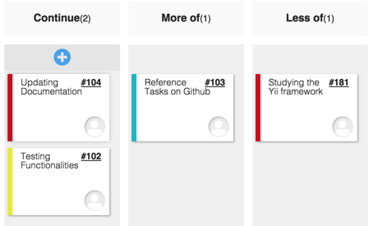
Sprint #3 Retrospective

Slide 19
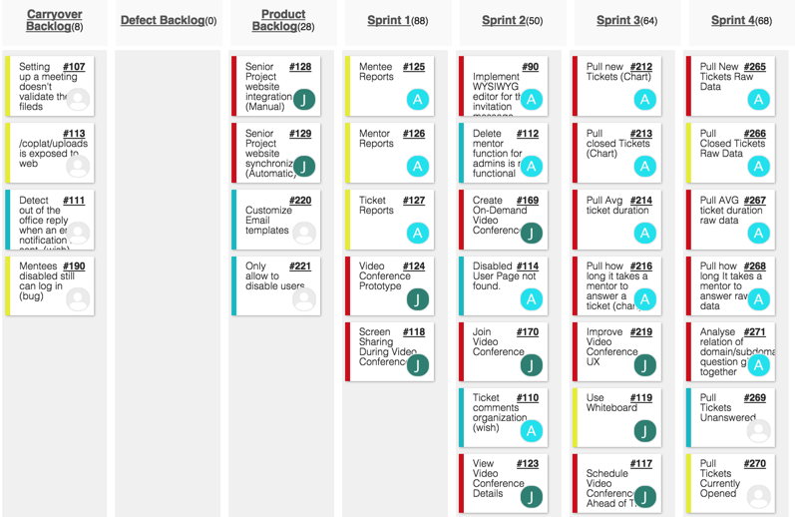
Sprint 4 Planning

Slide 20
Sprint # 4 Planning
User Story | Status | Points
Reject VC Invitation | To-Do | 8
Accept VC Invitation | To-Do | 8
Schedule VC From Ticket | To-Do | 8
Use Chat Room | To-Do | 8

